Slide 1
LET’S CHALL
letschall.com

Slide 2
SOCİAL NETWORK
Social media is used by most people and world change with it.

Slide 3
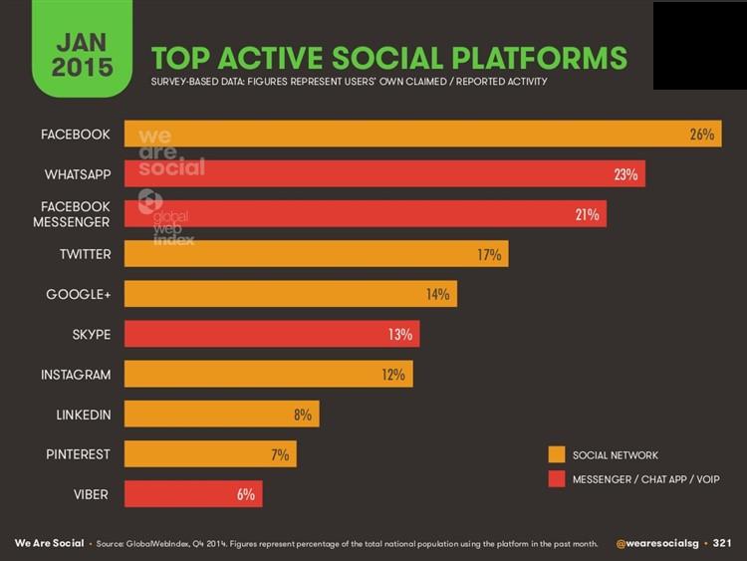
WORLD CHANGE.WHAT ABOUT US ?
42 percent of people use Internet and 70 percent of these people use social media.
People use mostly ; Facebook,Twitter,Google Plus,Instagram,Linkedin and Pinterest.
Therefore,We want to join and contribute this world.

Slide 4
LET’ S CHALL FEATURES
Letschall.com is a microblog website like Instagram with some new features.
Thanks to our website users can ;
-Upload their photos/videos,
-Follow other users,
-Challenge photos/videos with other users for 24 hours.

Slide 5
LET’S CHALL FEATURES
Using our website,people can see billion photos/videos at anywhere.
In addition,users not only see or upload but also challenge with others photos/videos.
Users follower give score between 1 and 10 for photos/videos.
Therefore,It is also a race and we think,it is more fun.

Slide 6
FUTURE AİMS
Our project also is good idea for smartphones so we will code android in the future.
With smartphones we aim to reach most users.
If number of users increase,our project can be used at lots of platform.

Slide 7
EXAMPLES OF USAGE AREAS
Brands are scored their product with our platform.After challenge,Manufacturer know which products are prefered by costumer.It is smart date for marketing.
Sports clubs can challenge between transfer players.Then,club can transfer who fans want.

Slide 8
THANK YOU FOR YOUR ATTENTİON
Yağmur ERKEK
Denis Kadirov BASRİEV
Erdi TURHAL

